Slide 1

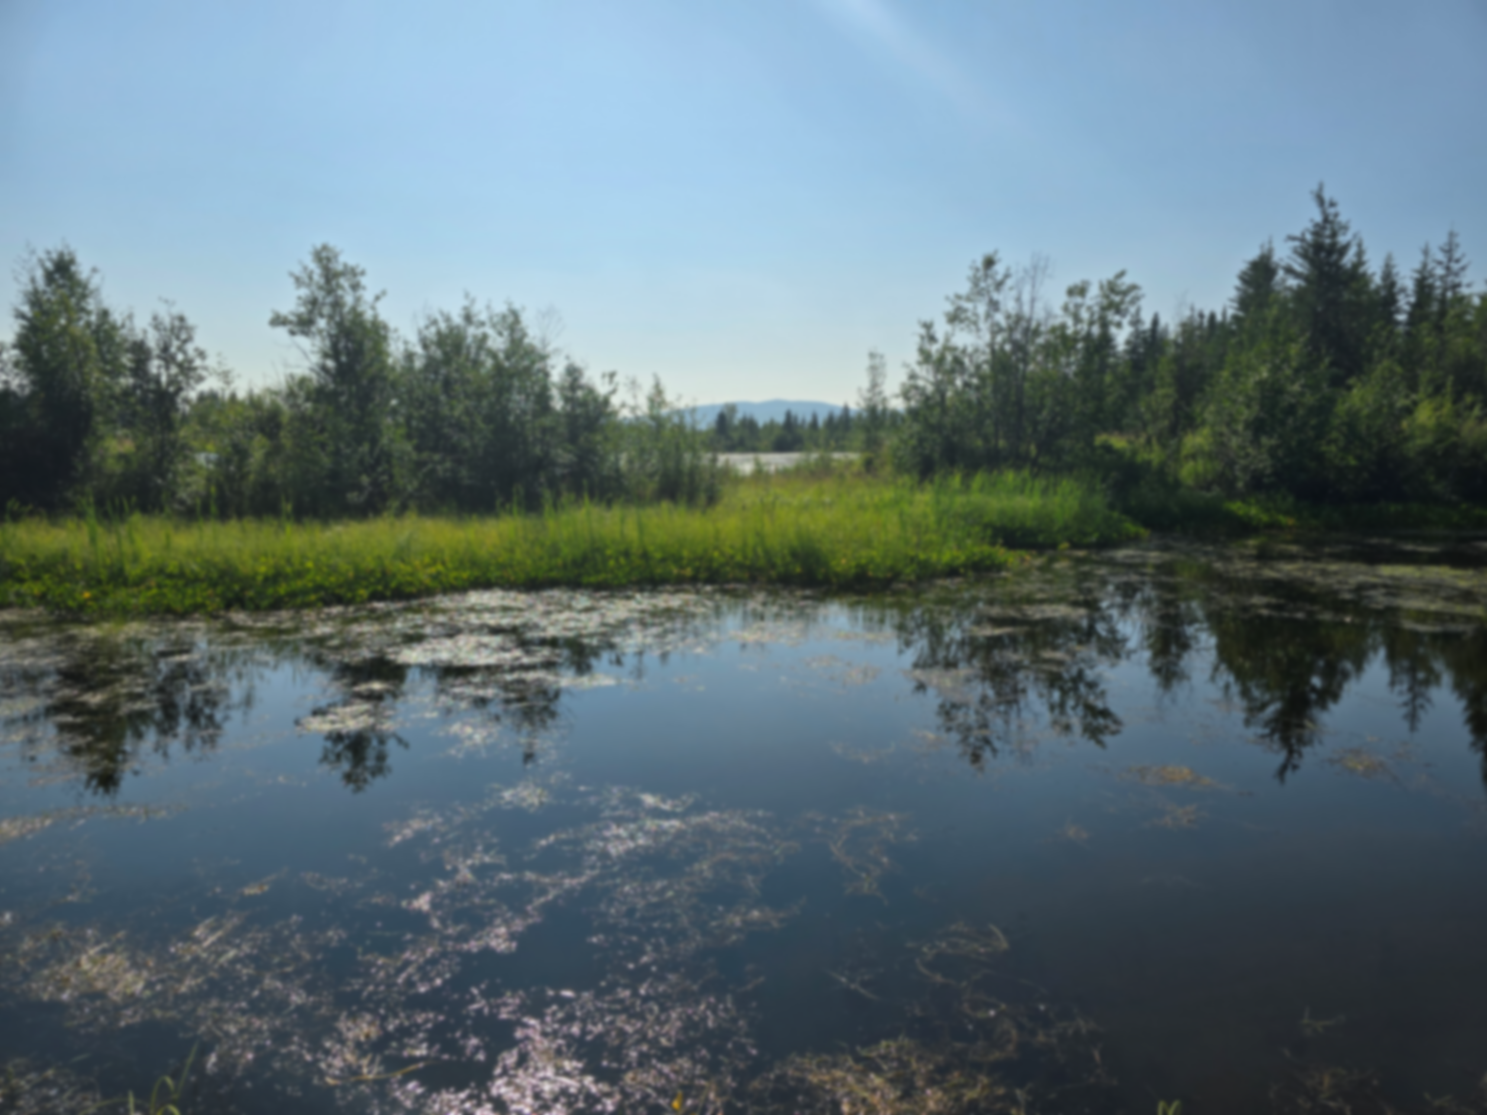


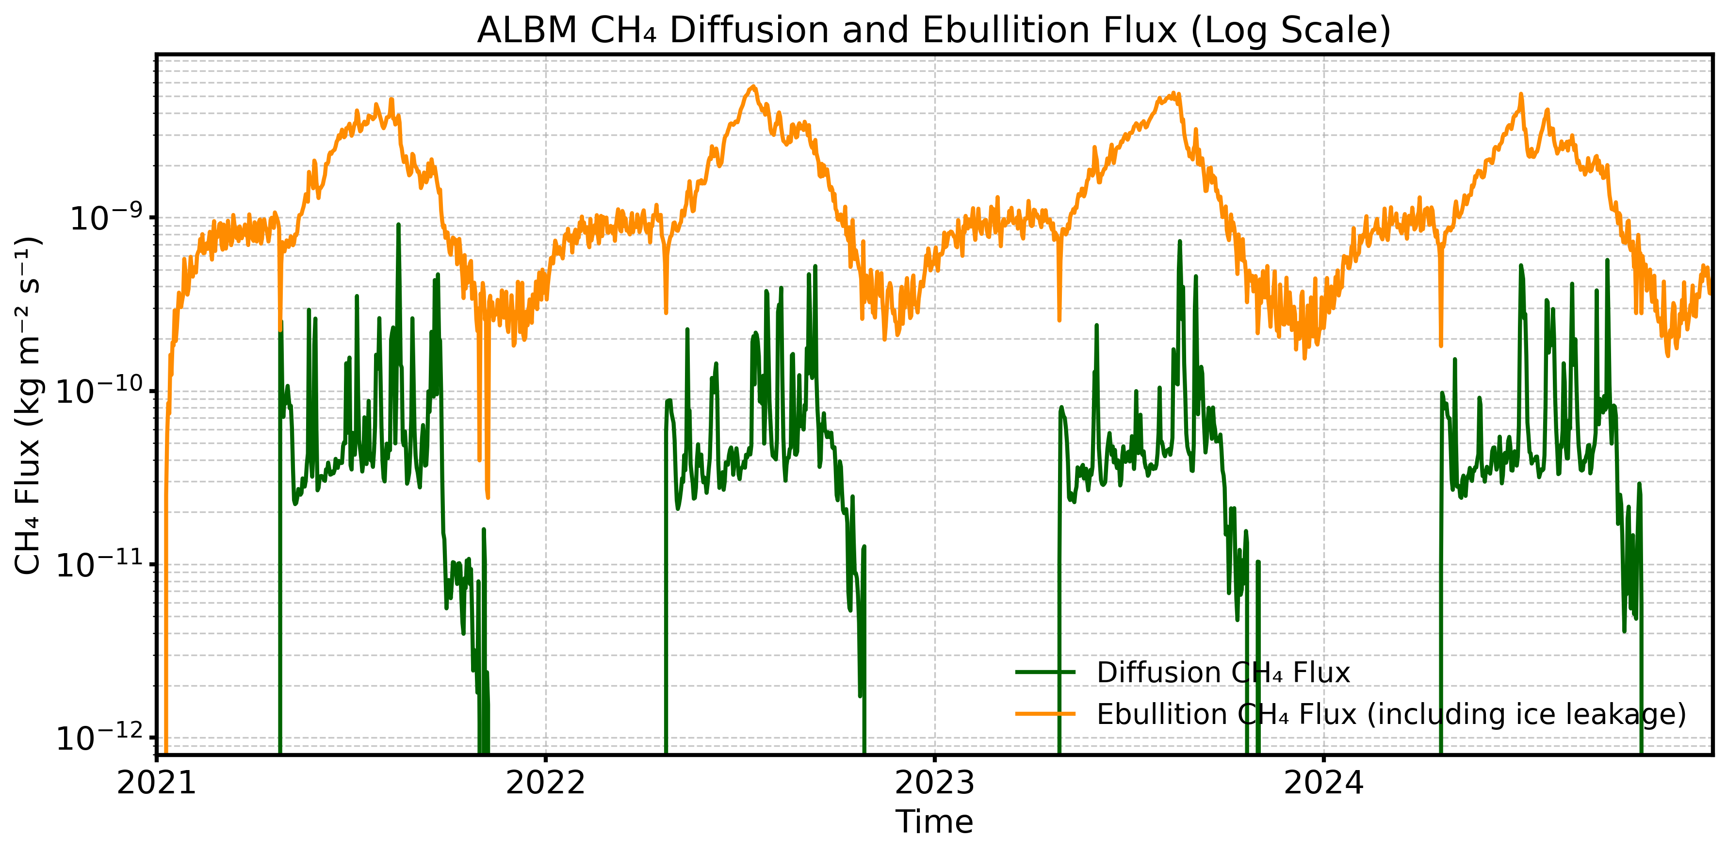

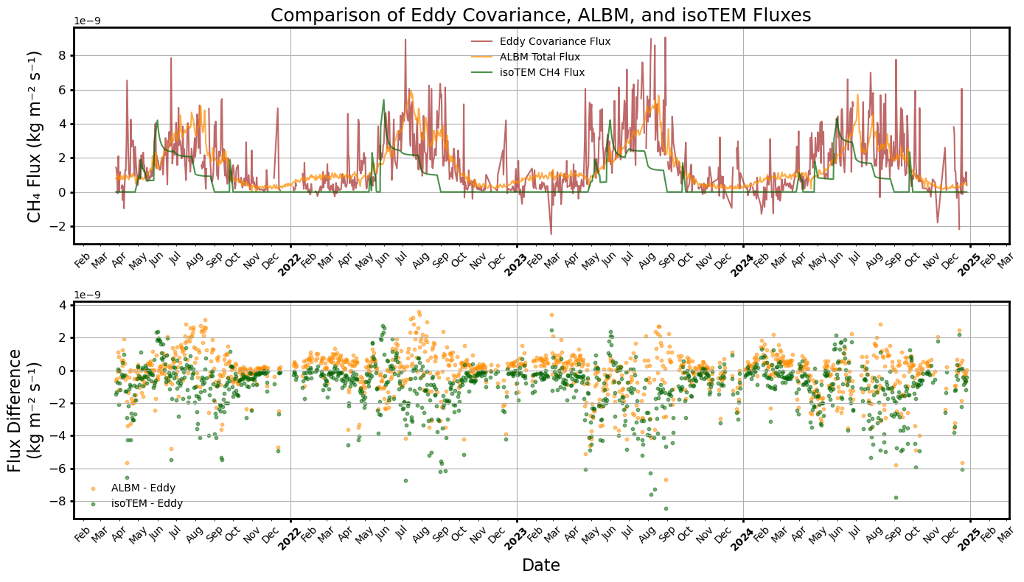
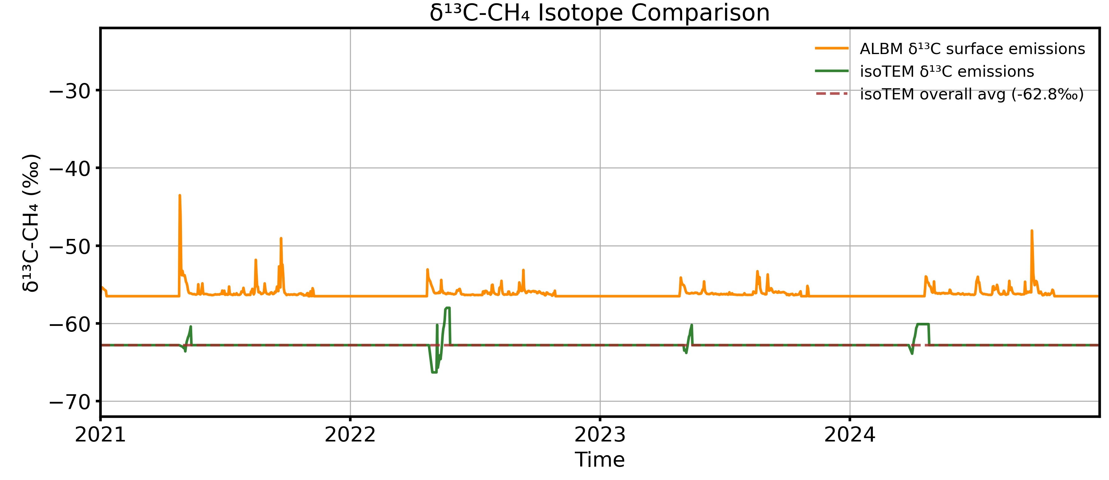

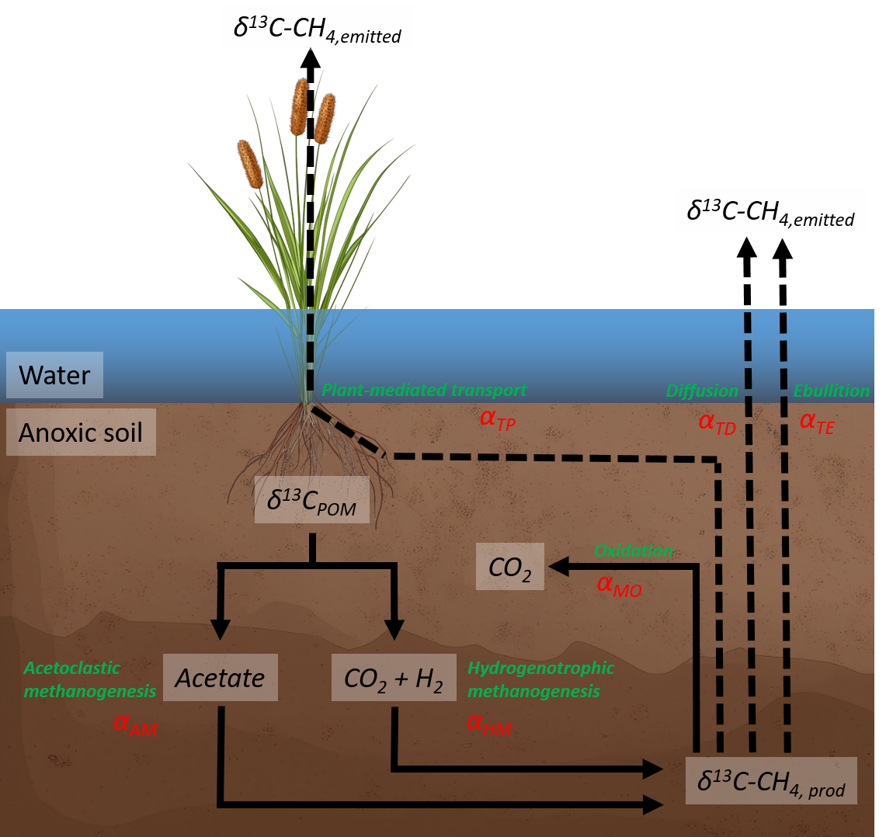
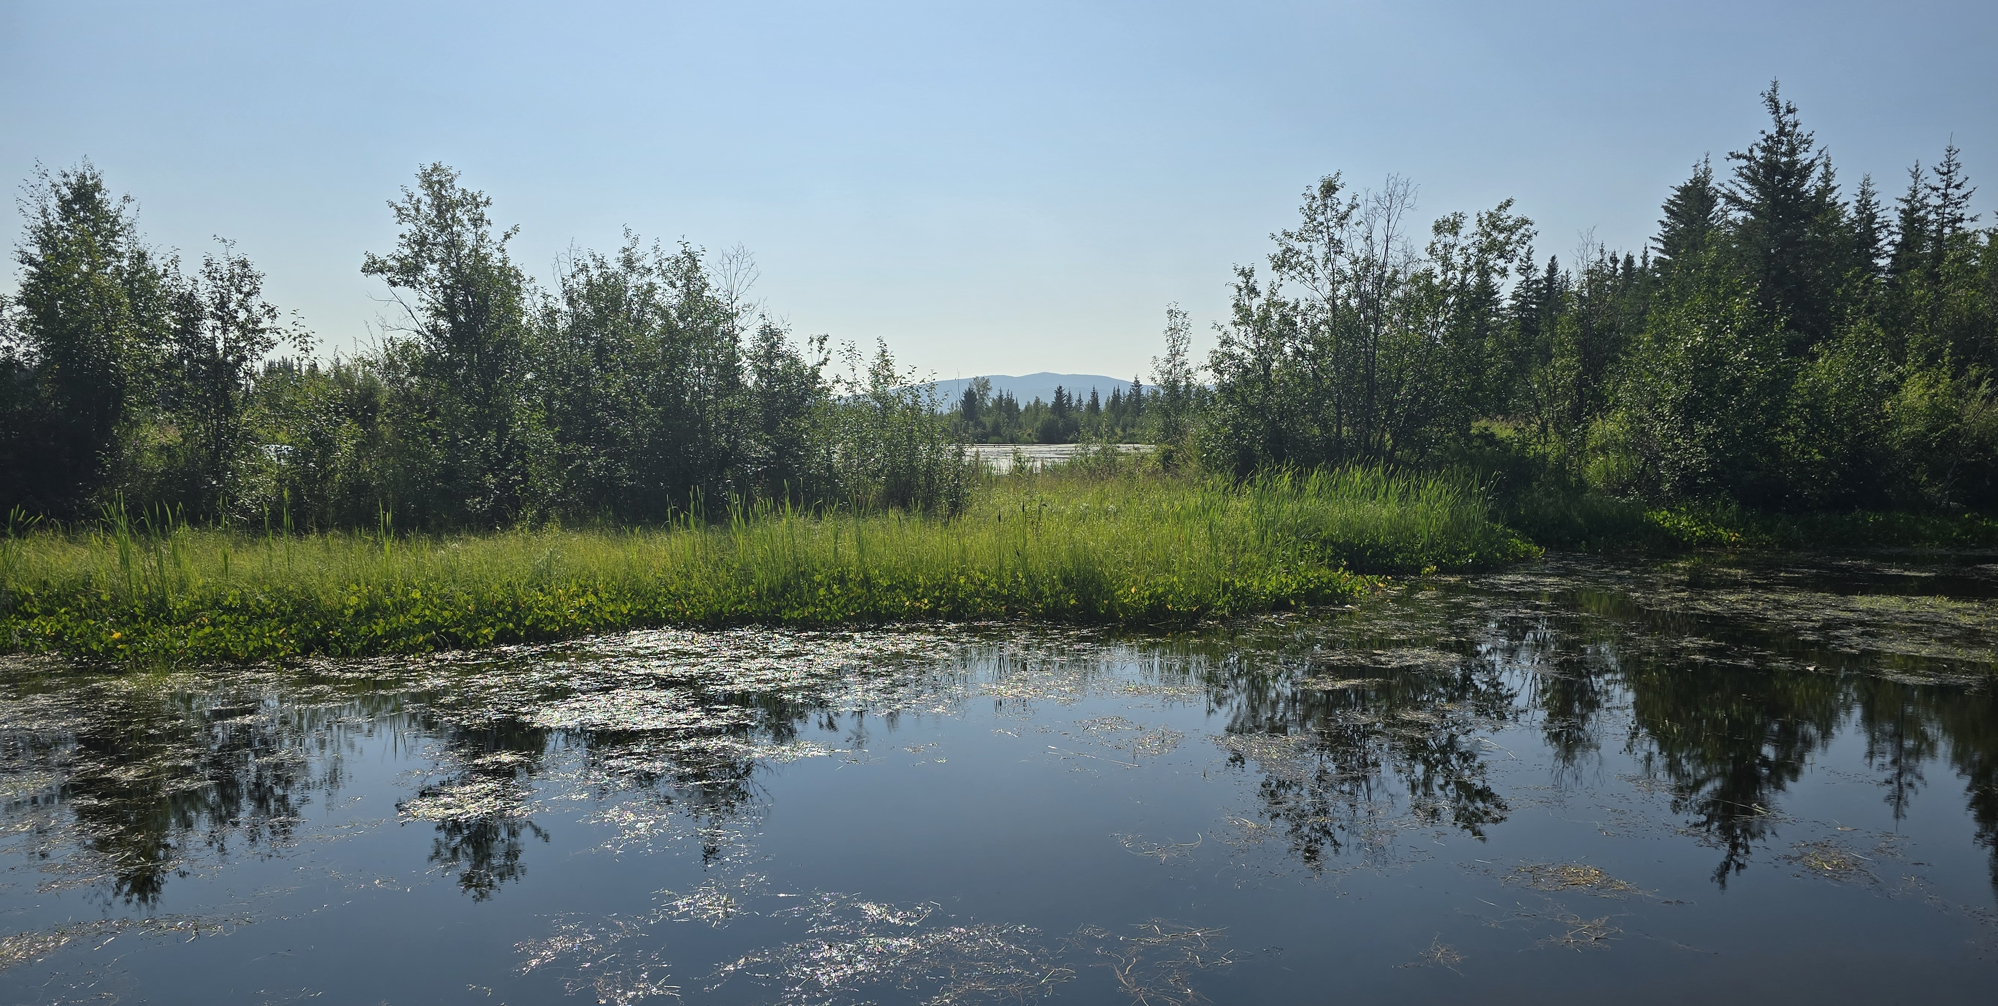
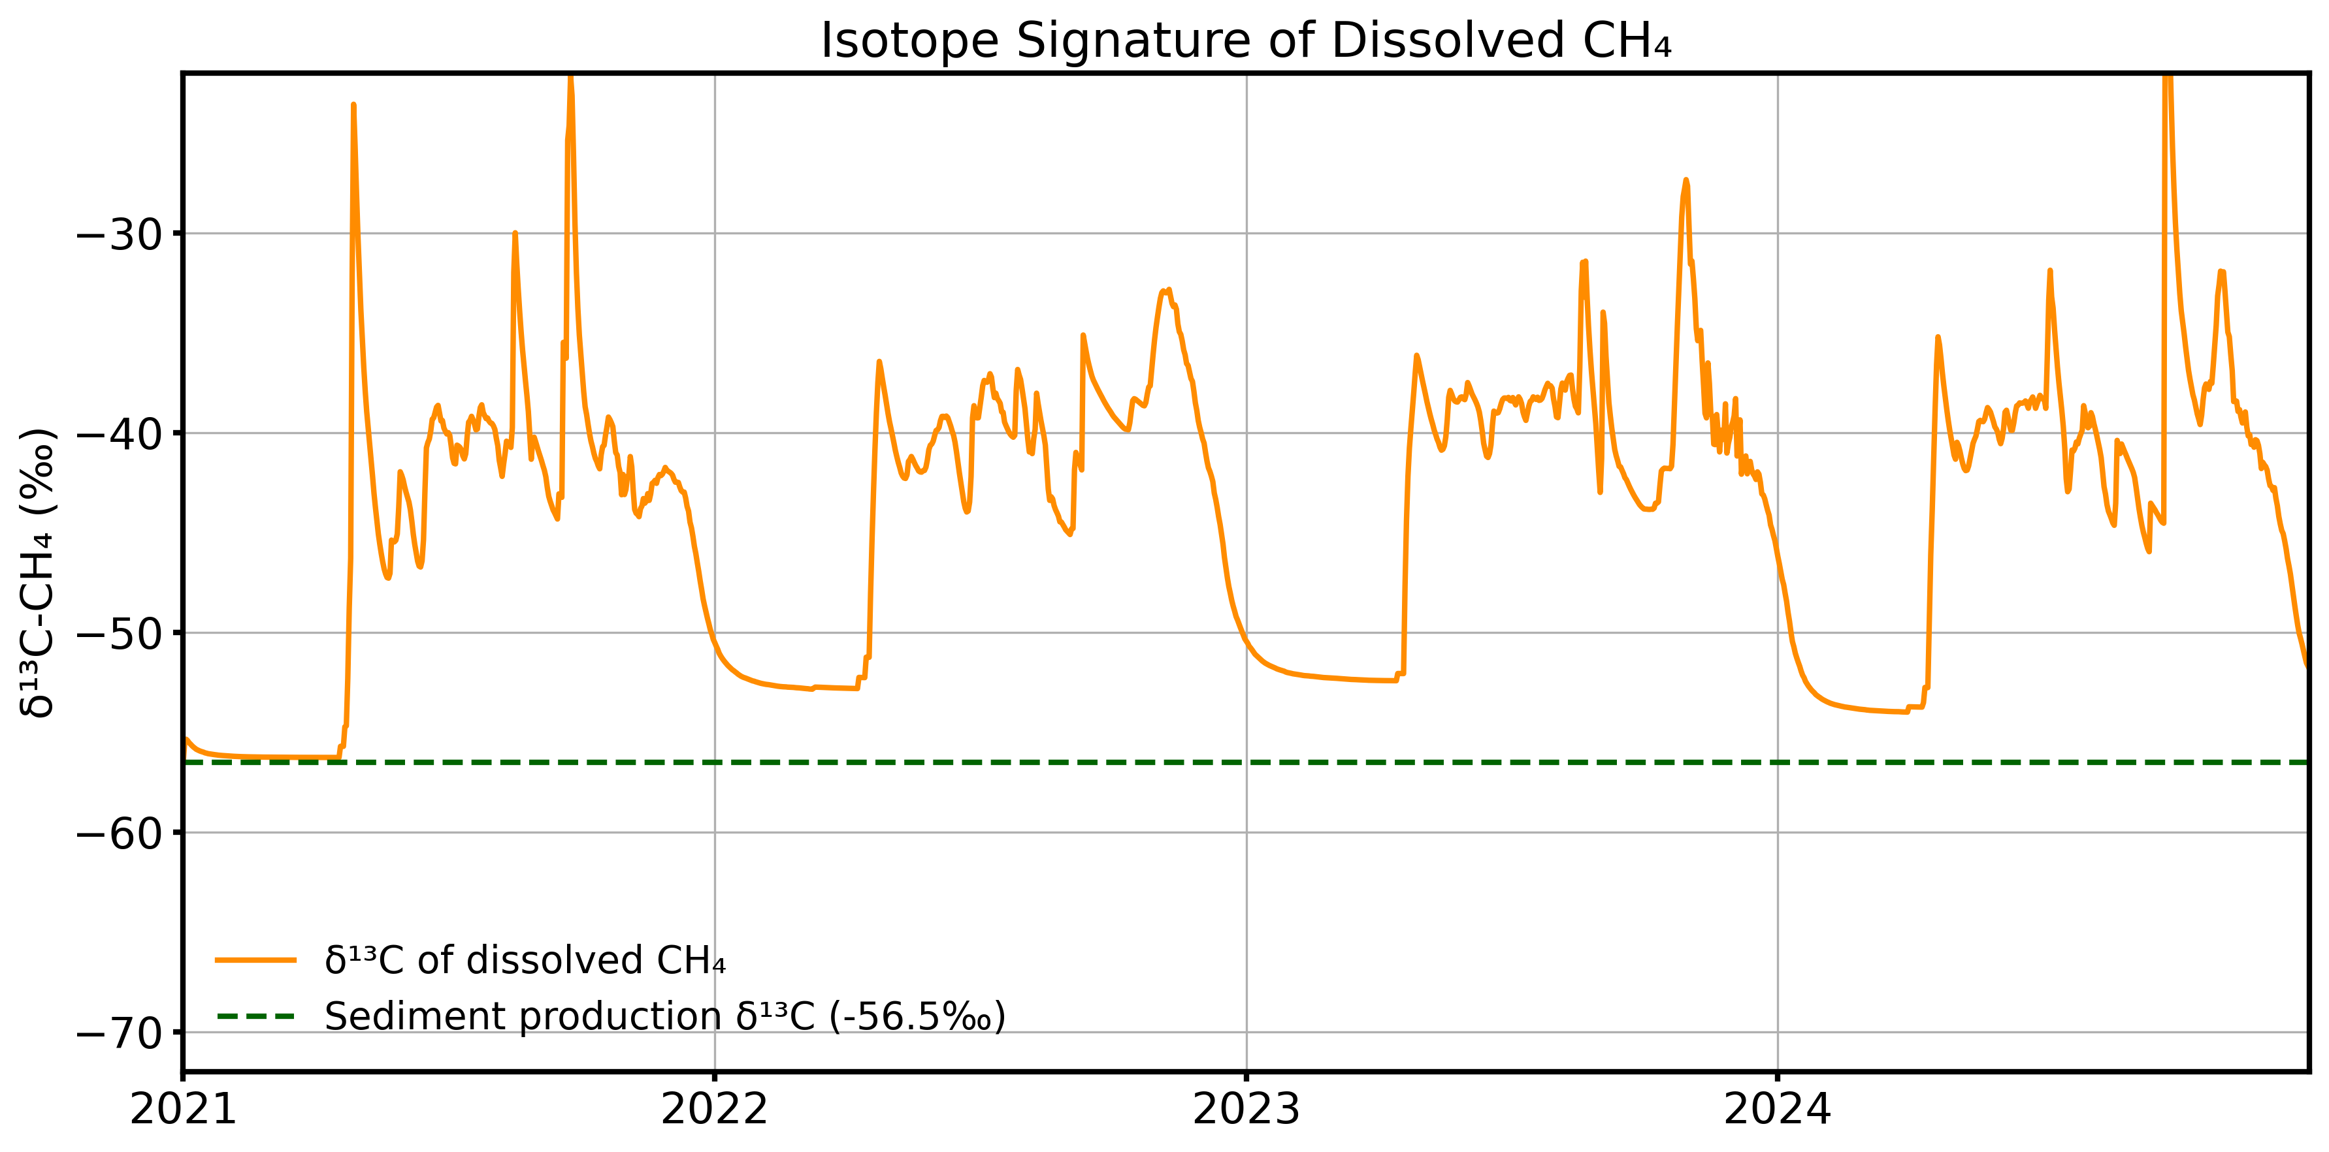




Multi-model Insights into δ¹³C-CH₄ from Arctic Permafrost Thermokarsts
This work is funded by NSF Navigating the New Arctic award #2022561
1. Motivation
4. Methane flux from ALBM
Methane is experiencing an accelerating increase in the atmosphere globally. Of the tools researchers have to diagnosis and determine the cause of rapidly changing sources and sinks of methane, its carbon isotope composition, δ¹³C-CH₄, is a promising option to reduce uncertainty and provide constraints on methane atmospheric inversions. A building consensus in literature points towards wetland emissions as the driving force behind increase emissions, yet our ability to be prescriptive of the wetland δ¹³C-CH₄ flux remains uncertain. Of wetlands, northern permafrost and its thaw features add additional complexities just as they add a large potential carbon stock for future methane release. Early models attempting to determine the δ¹³C-CH₄ of permafrost thaw predict that these landscapes will be isotopic endmembers, more depleted than any source on the planet. How does this prediction hold up against model realizations when downscaled to the site level?
Kevin S. Rozmiarek¹, Xiangyu Liu², Youmi Oh³ , Irina Overeem¹, Elijah A Miller⁴, Valerie Morris¹, Bruce H. Vaughn¹, Nicholas R. Hasson⁵, Brooke M. Chase¹, Katey M. Walter Anthony⁵, Qianlai Zhuang², Chuck Smallwood⁶, Gregory B. Rieker⁴, Tyler R. Jones¹
Processed-based model realizations of methane isotope flux reveals the controls on emissions from a thermokarst lake in Fairbanks, Alaska
2. isoTEM and isoALBM
We identify a relatively young and well-studied thermokarst (Big Trail Lake, Fairbanks, Alaska), to test model skill in downscaled methane carbon-isotope flux. We apply the isotope-enabled Terrestrial Ecosystem Model (isoTEM, Oh et al., 2022) and the Advanced Lake Biogeochemical Model (ALBM, Zhuang et al., 2023) to which we add a carbon-isotope mass balance (isoALBM). By combining models with observations by an eddy-flux tower and eventually, the isotopic composition of gas from bubble traps at Big Trail Lake, we evaluate the ability for models to represent the scale at which observations are taken for emergent rapid thaw permafrost features.
Diffusion and ebullition over the model period from ALBM. Ebullition includes bubble leakage upwards during winter months
5. Benchmarking against eddy flux
Ebullition is the dominate emission path!
Otherwise, about as much is consumed by oxidation that is emitted
Hydrostatic pressure, a control on bubble formation is low (avg. lake depth of 1.2 m) and thus methane accumulation is small
In productive lake environments, model results predict that ebullition is isotopically reflective of production, over alternative transport pathways or oxidation
Some key observations:
ALBM slightly underestimates methane release, likely driven by inability to fully capture winter season emissions and variability.
Both models capture seasonal cycle.
isoTEM more severally underestimates emissions as we might expect from differences in thermal model, which has a different energy balance than a lake
isoTEM emission is slanted towards the beginning of the warm season
isoTEM
First carbon isotope-enabled wetland model
Driven by meteorological and static soil/organic state variables
Does not represent lake system well
isoALBM
Carbon isotopes added in this study
Driven by meteorological, radiation budget, and static lake/soil state variables
Represents lake production well
6. Methane Isotopes
3. Isotope System
RMSE of isoTEM from observations: -56.4%
RMSE of ALBM from observations : -3.1%
Carbon-isotopic composition of methane emitted at the water surface in ALBM and isoTEM weighted by methane flux for the modeling period.
Emitted methane determined for the period of measured methane eddy-flux at Big Trail Lake. In burgundy is methane flux from March 2021-2024. In orange is ALBM model flux for the period. In green is isoTEM flux, likewise for the measurement duration.
Methane isotopic exchange in a wetland/lake system. Species are highlighted in white. Processes are labeled in green. Fractionation factors associated with each process are labelled in red. Pathways are assumed unidirectional and shown as black arrows for chemical processes and dashed for transport processes. Art assets made with Midjourney V6.1
Carbon-isotopic composition of methane dissolved in water in ALBM for the modeling period. The production signal is in the dashed green line and also serves as the initial value at model start.
If ebullition dominates, then the main control on the isotopic composition of dissolved methane is our decision on methanogenic pathway and oxidation.
This enriches methane relative to past predictions
In contrast to wetland and soil setting, getting the right answer for lakes isotopically is more about soil production than transport pathway.
Carbon isotopes are partitioned by fractionation factors as different carbon reservoirs go through various chemical and physical processes. We utilize the carbon-isotope mass balance of isoTEM and apply it to ALBM model fluxes.
Start with carbon-isotopic composition of soil (here measured via IRMS from cores to be ~25‰)
Substrate undergoes two different methanogenesis pathways into methane, fraction of each pathway determined by linear regression of geochemical state variables across metanalysis.
Produced methane then is either oxidized, determined by reaction kinematics OR:
Transported via three different transport pathways (no plant-mediated transport in ALBM)
Emitted methane is weighted by flux to determine carbon-isotopic composition of total methane flux.
Places
¹Institute of Arctic and Alpine Research, University of Colorado Boulder, Boulder, CO, USA
²Department of Earth, Atmospheric, Planetary Sciences, Purdue University, West Lafayette, IN, USA
³NOAA Global Monitoring Laboratory, Boulder, CO, USA
⁴Precision Laser Diagnostics Laboratory, University of Colorado, Boulder, Colorado, USA
⁵Water and Environmental Research Center, University of Alaska Fairbanks, Fairbanks, Alaska, USA
⁶Sandia National Laboratories, Albuquerque, New Mexico, USA
To come: Comparisons to bubble trap methane carbon isotopes
References
Oh, Youmi, et al. "Improved global wetland carbon isotopic signatures support post-2006 microbial methane emission increase." Communications Earth & Environment 3.1 (2022): 159.
Zhuang, Qianlai, et al. "Current and future global lake methane emissions: A process‐based modeling analysis." Journal of Geophysical Research: Biogeosciences 128.3 (2023): e2022JG007137.
KevRozmiarek.github.io

